Slide 1


Adama Science and Technology University, Department of Computer Science and Engineering
Balancing Act : The Role of Human Oversight in AI
Melat Desta
08/03/2024

Slide 2
What is human oversight?
Involvement of humans in the entire AI lifecycle, from development and deployment to use and monitoring.
Human oversight can be seen as one specific aspect of human agency, focusing on the active supervision and monitoring of AI systems to ensure they operate as intended, and to prevent undesired AI functionalities, outcomes or consequences.

Slide 3
Human oversight policies
European commission AI Act
“for high risk AI system ,[…] human oversight [..is ] strictly necessary to mitigate the risks to fundamental rights and safety posed by AI.

Slide 4
AIA (European Commission 2021)
Human oversight in high-risk AI systems while, human supervision is optional at lower levels of risk.
The high-risk AI systems are generally defined in Article 6 and specified in the AI Act.
These include scenarios where automation can be applied, like
criminal justice
child welfare
human resource recruitment
use of biometric data for individual identification.

Slide 5
Approach1:Restrict “solely” automated decision.
GDPR Article 22:”The data subject shall have the right not to be subject to a decision based solely on automated processing”
Northpoint guide to COMPAS:” staff should be encourage to use their professional judgment and override the computed risk as appropriate ”.
Approach2:Require human discretion.
Article 29 Data Protection Working Party; “to qualify as human involvement ,the controller must ensure that any oversight of the decision is meaningful ,rather than just a token gesture”.
Approach3:Restrict “meaningful” human input.

Slide 6
HLEG on AI’s White Paper on AI
(European Parliament and Council of the European Union 2016).
The output of the AI system does not become effective unless it has been previously reviewed and validated by a human to confirm the decision.
The output of the AI system becomes immediately effective, but human intervention is ensured afterwards to override the decision.
Monitoring of the AI system while in operation and the ability to intervene in real-time and deactivate in the design phase, by imposing operational constraints on the AI system.

Slide 7
Canadian Directive on Automated Decision –making
Decisions likely to have “high” or “very high” social impact “can not be made with out having specific human intervention points during the decision-making process ;and the final decision must be made by ”.

Slide 8
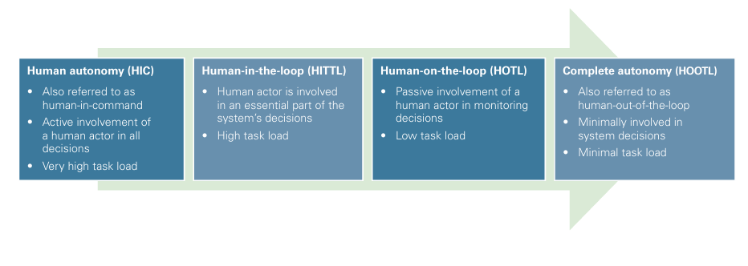
Well-known Approaches

Slide 9
Human-in-the-command (HIC)
HIC refers to Humans supervise on the operation of the AI system and its deployment status. HIC is also discussed in terms of human autonomy.
Supervision and Deployment
Human actors monitor the AI system's performance and ensure it is functioning correctly.
Humans are involved in the deployment of AI systems, meaning they oversee when and how these systems are put into action.

Slide 10
Human Autonomy
Humans are not just passive observers but are actively engaged in every step of the process.
Setting up tasks for the AI.
Monitoring the AI’s performance.
Making decisions based on the AI’s output.

Slide 11
Human-in-the-command (HIC)
Pro | Con
Low risk of “unfair AI” causing adverse effects on society. | Incorporates all kinds of human weaknesses (boredom, fatigue, anxiety ,human bias)
The human agent remains in full control in of the process. | Very high task load on human agent

Slide 12
Human-in-the-Loop (HIL)
HIL refers to situations where humans are an integral part (considered as a system component) of the AI process cycle.
This describes a human-AI collaboration within the learning and/or decision-making processes, and is divided into two categories.

Slide 13
Integrate humans into the algorithmic learning process
Human-Assisted Machine Learning
Explanatory Mechanisms for Human Understanding
Annotators
Interactive Input or Feedback Providers
Structuring Training Data
Explanations for AI Decisions
Followability and Understanding

Slide 14
beyond the technical implementation of the learning process
does the AI system adhere to usability requirements during the AI learning process and the system deployment, e.g. is proper data or human expertise available (useable AI)?
can the AI system be used sensibly and effectively by, and according to, the requirements of the target user group (useful AI)?

Slide 15
Human-in-the-Loop (HITL)
Pro | Con
High degree of transparency | Demands a fitting level of task granularity and task distribution
Utilization of human judgement | Prone to human bias
Allows for algorithmic imperfection | Not suited for strongly dynamic systems where real-time decisions are essential

Slide 16
Human-on-the-loop (HOTL)
In HOTL humans monitor and potentially guide the design and progress of an AI system from outside the AI process cycle.
Their role is to interact with the system as a supervisor or arbiter, aiming to ensure the safe operation of the system.
HOTL is mostly implemented in highly dynamic systems, for instance, in manufacturing system control.

Slide 17
Human-on-the-loop (HOTL)
In this approach, the human actor is not heavily involved, and only intervenes if the machine fails or has a high probability of failing, i.e. in the case of unexpected, uncertain events, or if crucial decisions take place.

Slide 18
Human-on-the-loop (HOTL)
Pro | Con
Higher processing speed (no real-time human response) | Not recommended for high risk systems unless higher safety can be achieved through automation rather than human intervention

Slide 19
Human-out-of-the-loop (HOOTL)
Humans are not involved in the AI tasks, and the system can operate without human input.
The approach is also referred to as complete autonomy or system automation, where the attempt is to operate a system without, or with only minimal, input/intervention from a human agent.
Application areas of HOOTL approaches are, for example, military applications, or for vehicles or robots where AI decisions must be made in an instant.

Slide 20
Human-out-of-the-loop (HOOTL)
The main aim is to maximize the efficiency and productivity of the system, where the technology is optimized for accuracy and physical safety.
Compared to the other approaches, commercial interests are at the center of the application and are typically prioritized over user interests.

Slide 21
Human-out-of-the-loop (HOOTL)
Pro | Con
Minimal task load for human agent | Lack of human control
Comparably low costs in operation | Higher costs in development

Slide 22
The complexities of human oversight
Finding right balance between automation and human oversight is complex and hard to achieve. The most important factors to consider are
The trade-off between cost and control ,as human involvement during the application lifetime is expansive.
The ethical and moral principle of the application context.

Slide 23
Humans have limited capacity to interpret and process complex information in short periods of time or when under pressure
Humans have difficulty understanding the algorithm’s role in the course of a decision
Humans are unlikely to question suggestions made by algorithms (over-reliance)
Humans may erroneously value human judgement over algorithmic recommendation (under-reliance)

Slide 24
Meaningful oversight is when operators exercise their agency while being aware of the system’s (and their own) biases or limitations.
This would mean human operators are able to prevent harms if they can understand when an algorithm errors, understand why an algorithm has made a decision and account for the potential biases of the system.

Slide 25
According to the AI Act, human overseers should be able to
• understand the capacities and limitations of the high-risk AI system
• remain aware of the possible tendency of automatically relying or over-relying on the output produced by a high-risk AI system.
• be able to correctly interpret the high-risk AI system’s output.
• be able to decide, in any particular situation, not to use the high-risk AI system or otherwise disregard, override or reverse the output of the high-risk AI system
• be able to intervene in the operation of the high-risk AI system or interrupt the system.

Slide 26
Thanks!

